Slide 1
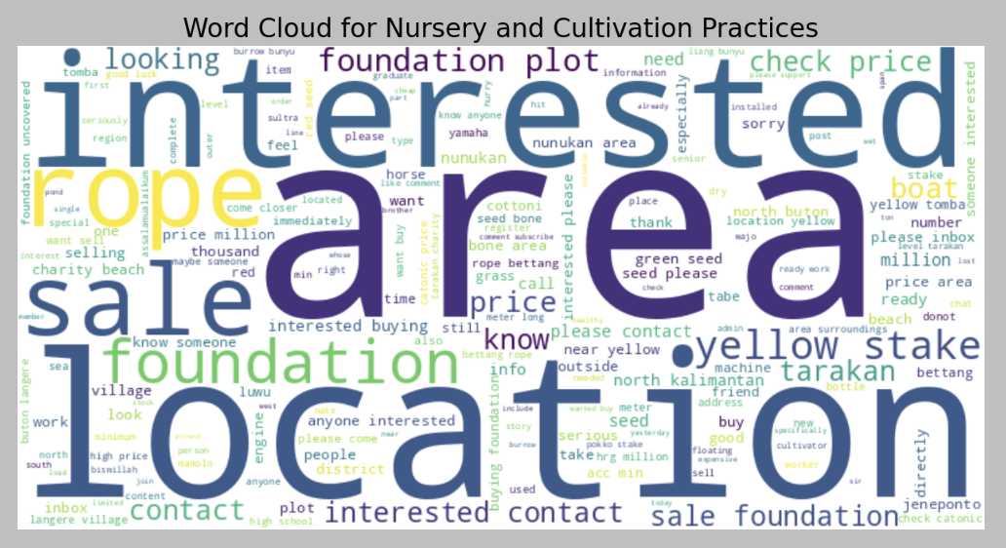
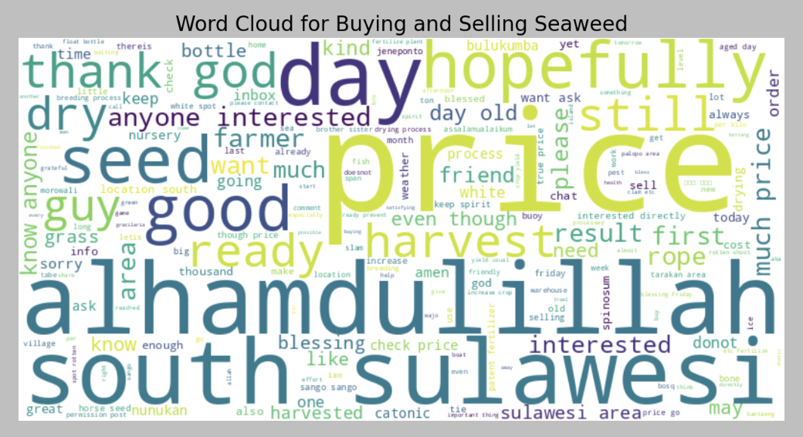
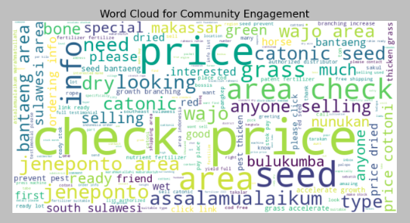
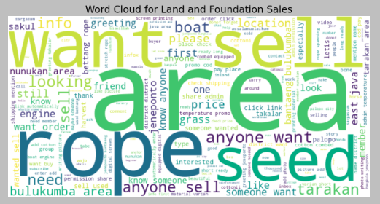
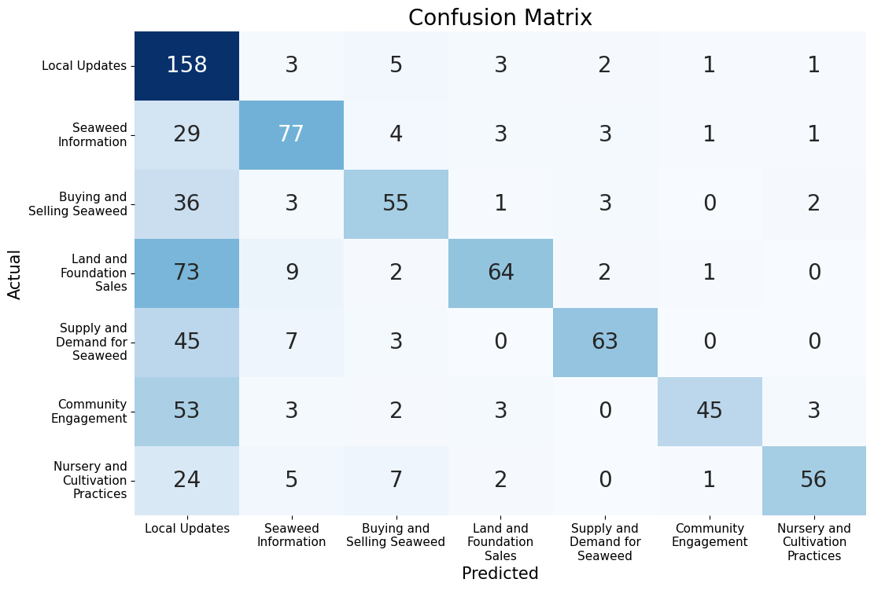
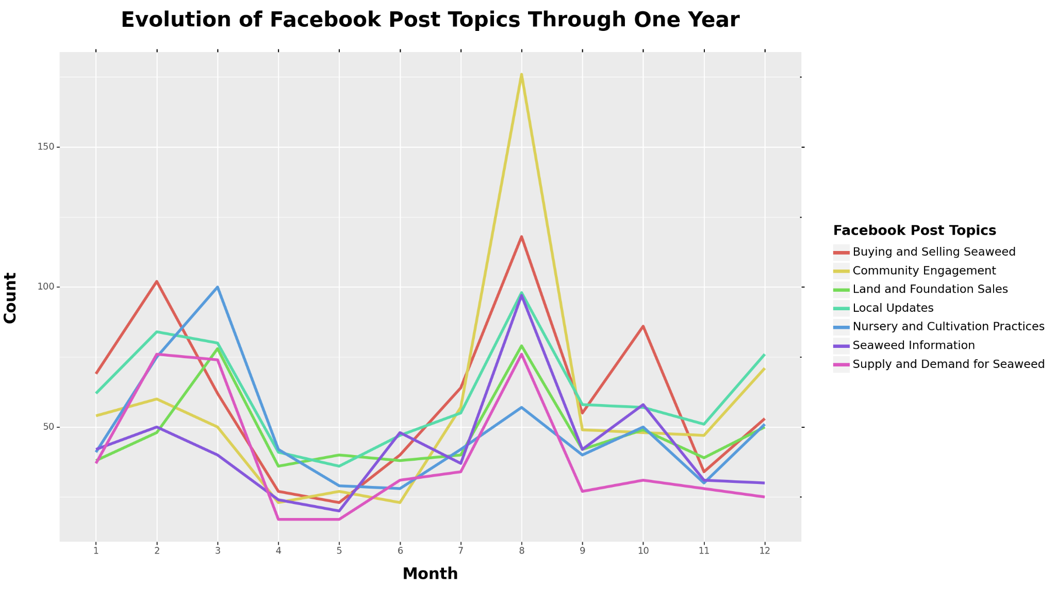
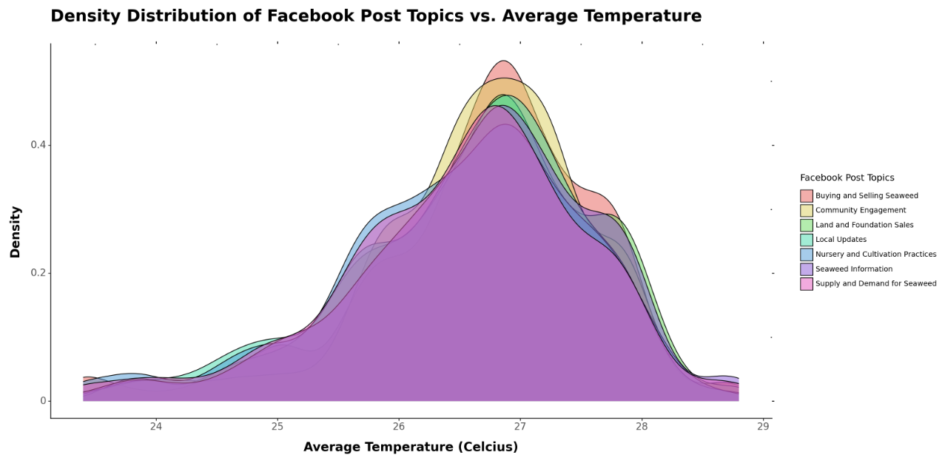
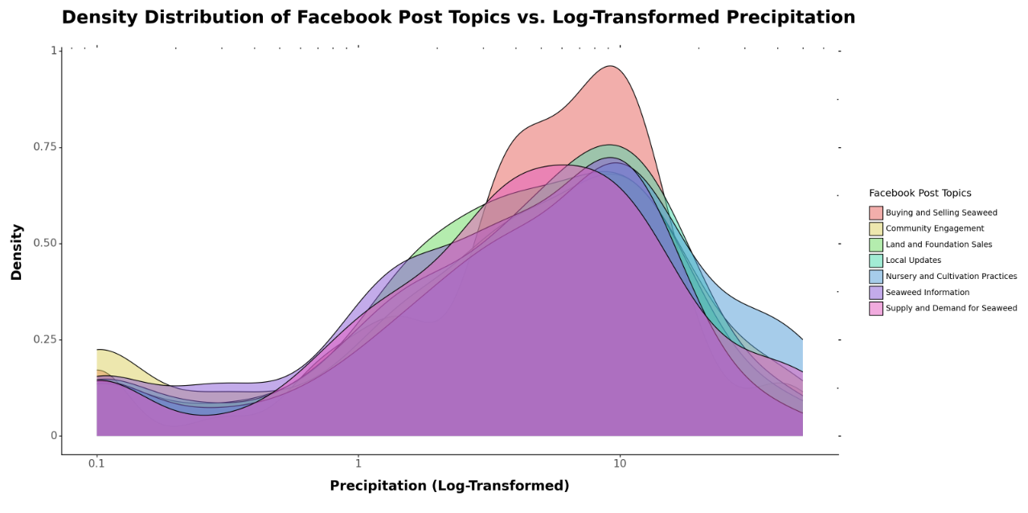
Information Sharing in Seaweed Farming: Investigating the Dynamics of Participation in Facebook Groups Among Indonesian Seaweed Farmers
Context
Research
Discussion
Background
Data Exploration
Model Accuracy
Conclusion
Research Questions
Joining Weather Data
Next Steps
Dataset
Data Citations:
Kaylee Shen, B.S. Earth Systems, Doerr School of Sustainability
kayshen@stanford.edu | Stanford University, DATASCI 112, Spring 2024
Seaweed farming is an important source of income for Indonesia's coastal communities. However, Indonesian seaweed farmers face challenges such as price transparency, market access, and access to quality seedlings. Like many other small-scale producers, they live at subsistence levels.
There is growing academic interest in the use of online information sharing platforms to improve seaweed farmer livelihoods, such as through increased price transparency and access to larger markets. This project analyzes the trends in the most commonly discussed topics on Facebook, a popular platform used by seaweed farmers, in an attempt to understand how seaweed farmers utilize with current technologies.
I applied tf-idf to textual data from Facebook posts and used unsupervised Latent Dirichlet Allocation (LDA) to find recurring themes in the Facebook posts. Sample word clouds are shown below.
To evaluate the accuracy of the model, I fit a KNN Classifier model (k = 3) and predicted the topic. Due to many posts having characteristics of multiple topics, the recall is low. Below is the resulting confusion matrix. F1_macro score: 0.60
Analysis
The graph on the right shows trends in which themes were more commonly discussed each month. August had the greatest number of Facebook posts, with spikes in February and March.
Other studies indicate that tropical seaweed grows well in dry season, which is between May and October for Sulawesi (where the majority of Indonesian seaweed is grown). The results from this data indicate a greater number of posts during dry season, which suggest that seaweed farmers use Facebook more when there is increased seaweed growth. This indicates that farmers are using Facebook to assist in their seaweed related activities.
Dry Season
The common topics in seaweed farming Facebook posts include buying and selling seaweed and community engagement– a category for posts that do not have a particular inquiry, but are simply checking the average prices of an area, sending greetings, or words of encouragement to other farmers. Community engagement spikes during dry season, which is when seaweed grows the best.
Furthermore, there are more posts about buying and selling seaweed throughout the year, but discussion on nursery and cultivation practices peak in March, which suggests that March is a common time for seaweed farmers to be preparing their farms for increased seaweed growth in the dry season.
What are the most common topics mentioned in seaweed farming Facebook posts?
How does the frequency and content of posts change throughout one year?
How does the frequency and content of posts change depending on local weather factors?
Possible ways to improve the model include implementing semi-supervised LDA to facilitate more refined clustering and using other metrics of model performance, in addition to the f1_macro and coherence score. Comparing the LDA model with K-Means Clustering would be another way to confirm that LDA is the best model for data analysis.
I used seaweed farming Facebook posts collected from September 1st, 2021 to August 29th, 2022. I then joined weather and climatic data from Meteostat, which provides open weather and climate data. I used weather data from Makassar, a city near Indonesia’s largest seaweed farming hotspot.
The two graphs above indicate that there is not a significant difference between topics discussed in seaweed farming Facebook groups given different temperatures and levels of precipitation. A possible explanation for the lack of differentiation between topics discussed is that precipitation and temperature are highly location dependent, and the members of the Facebook group could be from vastly different locations, which would suggest a lack of post differentiation due to weather events. This may indicate the diversity in locations where users are located.
Grist, Madelaine. 2022. “Propagule Distribution Systems of Tropical Carrageenan
Seaweed in South Sulawesi: Value Chain and Social Media Analyses.” Bachelor Degree Research Thesis, School of Agriculture and Food Science, University of Queensland (AGRC6001).
“Makassar.” Meteostat,
https://meteostat.net/en/place/id/makassar?s=97180&#38;t=2022-08-04/2022-09-01.

